Slide 1
Lecture 2
Displaying Categorical Data
with Table

Slide 2
By the end of this section, you should be able to:
Make and interpret frequency table, relative frequency table and two-way table
Calculate marginal and joint relative frequencies from a two-way table
Calculate conditional relative frequencies from a two-way table

Slide 3
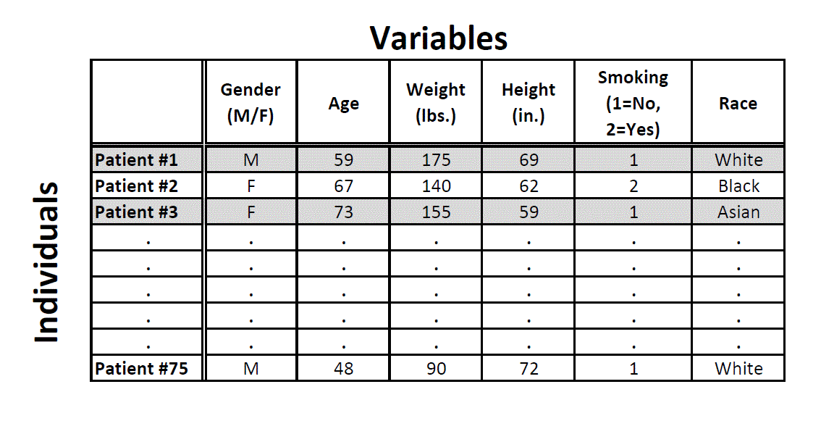
How to measure categorical variables?
categorical
categorical
categorical
Frequency (counts)
Relative Frequency (percentage/proportion)

Slide 4
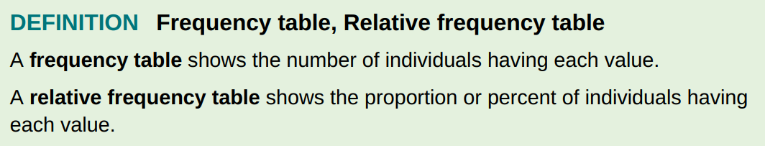
Some people use the terms frequency distribution table and relative frequency distribution table instead.

Slide 5
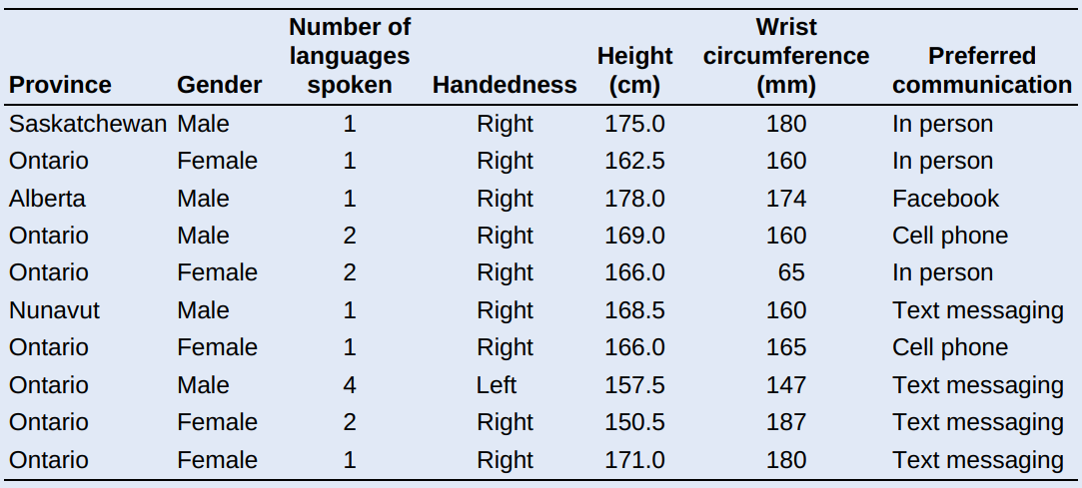
PROBLEM: Census At School is an international project that collects data about primary and secondary school students using surveys. Hundreds of thousands of students from Australia, Canada, Ireland, Japan, New Zealand, South Africa, South Korea, the United Kingdom, and the United States have taken part in the project. Data from the surveys are available online. We used the site’s “Random Data Selector” to choose 10 Canadian students who completed the survey in a recent year. The table displays the data.

Slide 6
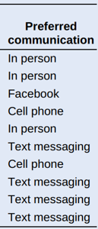
Note that the frequencies and relative frequencies listed in these tables are not data !!!!!!!
Preferred Communication | Frequency
In Person | 3
Facebook | 1
Cell Phone | 2
Text Messaging | 4

Slide 7
Note that the frequencies and relative frequencies listed in these tables are not data !!!!!!!
Preferred Communication | Frequency
In Person | 3
Facebook | 1
Cell Phone | 2
Text Messaging | 4
Relative Frequency Proportion | Relative Frequency Percent
0.3 | 30%
0.1 | 10%
0.2 | 20%
0.4 | 40%

Slide 8
Two-Way Table
A two-way table describes two categorical variables, organizing counts according to a row variable and a column variable.
A two-way table is sometimes called a contingency table.
Young adults by gender and chance of getting rich
 | Female | Male | Total
Almost no chance | 96 | 98 | 194
Some chance, but probably not | 426 | 286 | 712
A 50-50 chance | 696 | 720 | 1416
A good chance | 663 | 758 | 1421
Almost certain | 486 | 597 | 1083
Total | 2367 | 2459 | 4826
What are the variables described by this
two-way table?

Slide 9

The marginal distribution of one of responses in a two-way table of counts is the distribution of values of responses among all individuals described by the table.
Marginal Distributions
The marginal distribution of one of the categorical variables in a two-way table of counts is the distribution of values of that variable among all individuals described by the table.
Young adults by gender and chance of getting rich
 | Female | Male | Total
Almost no chance | 96 | 98 | 194
Some chance, but probably not | 426 | 286 | 712
A 50-50 chance | 696 | 720 | 1416
A good chance | 663 | 758 | 1421
Almost certain | 486 | 597 | 1083
Total | 2367 | 2459 | 4826

Slide 10
Marginal Distributions
The marginal distribution of one of the categorical variables in a two-way table of counts is the distribution of values of that variable among all individuals described by the table.
Young adults by gender and chance of getting rich
 | Female | Male | Total
Almost no chance | 96 | 98 | 194
Some chance, but probably not | 426 | 286 | 712
A 50-50 chance | 696 | 720 | 1416
A good chance | 663 | 758 | 1421
Almost certain | 486 | 597 | 1083
Total | 2367 | 2459 | 4826

Slide 11
Marginal Distributions
Frequency Table
Almost no chance | 194
Some chance, but probably not | 712
A 50-50 chance | 1416
A good chance | 1421
Almost certain | 1083
Total | 4826
Relative Frequency Table
Almost no chance | 0.040
Some chance, but probably not | 0.148
A 50-50 chance | 0.293
A good chance | 0.394
Almost certain | 0.224
Total | 1
These percents or proportions are known as marginal relative frequencies because they are calculated using values in the margins of the two-way table.

Slide 12

Note: Percentages are often more informative than counts, especially when comparing groups of different sizes.

Slide 13
How to examine a marginal distribution:
Use the data in the table to calculate the marginal distribution (in %) of the row or column totals.
Make a graph to display the marginal distribution.
Examine the marginal distribution of chance of getting rich.
Frequency Table
Almost no chance | 194
Some chance, but probably not | 712
A 50-50 chance | 1416
A good chance | 1421
Almost certain | 1083
Total | 4826
Relative Frequency Table
Almost no chance | 0.040
Some chance, but probably not | 0.148
A 50-50 chance | 0.293
A good chance | 0.294
Almost certain | 0.224
Total | 1

Slide 14
Conditional Distributions
Young adults by gender and chance of getting rich
 | Female | Male | Total
Almost no chance | 96 | 98 | 194
Some chance, but probably not | 426 | 286 | 712
A 50-50 chance | 696 | 720 | 1416
A good chance | 663 | 758 | 1421
Almost certain | 486 | 597 | 1083
Total | 2367 | 2459 | 4826
-Condition = ‘given’
-What percent of people
“almost certain”,
given they are female?
Given they are male?
Notes:
如果已知….， 这个等价于 …是一个条件

Slide 15
Young adults by gender and chance of getting rich
 | Female | Male | Total
Almost no chance | 96 | 98 | 194
Some chance, but probably not | 426 | 286 | 712
A 50-50 chance | 696 | 720 | 1416
A good chance | 663 | 758 | 1421
Almost certain | 486 | 597 | 1083
Total | 2367 | 2459 | 4826
Response
Almost no chance
Some chance
A 50-50 chance
A good chance
Almost certain
Female
96/2367 = 4.1%
426/2367 = 18.0%
696/2367 = 29.4%
663/2367 = 28.0%
486/2367 = 20.5%
Conditional relative frequency

Slide 16
Homework

